Slide 1
Grammar
The Attributive Clause
定语从句

Slide 2
Approaching Grammar
That’s why you go away
Baby won’t you tell me why? There is a sadness in your eyes.
I don’t wanna say goodbye to you.
Love is one big illusion I should try to forget.
But there is something left in my head.
You’re the one who set it up.
Now you’re the one to make it stop.
I’m the one whose feeling lost right now.
Now you want me to forget every little thing you said.
But there is something left in my head.
I won’t forget the way you’re kissing.
The feeling so strong！
Were lasting for so long!
But I’m not the man your heart is missing!
That's why you go away I know!

Slide 3
1.love is one big illusion which l should try to forget. 2.You're the one who set it up. 3. I 'm the one whose feeling lost right now. 4. Now you want me to forget every little thing that you said. 5. I won't forget the way that you're kissing 6. l'm not the man that your heart is missing!

Slide 4
Definition:
定语从句（the attributive clause）
在句子中起定语作用，修饰句中的名词或代词的从句称为定语从句，
被修饰的名词或代词叫________ ，引导定语从句的词叫做__________________________
“先行词”
“关系词”（关系代词和关系副词）

Slide 5
the Structure of the Attributive Clause
eg: The man who lives next to us is a teacher.
antecedent
(先行词)
attibutive clause
（定语从句）
relative pronoun（关系代词）

Slide 6
I like the notebook which/that is as big as my hand.
He is a boy who has long legs.
He is my brother whose house has been destroyed in the earthquake.

Slide 7
Antecedent（先行词） | Relative pronouns（关系代词） | Function（功能）
People （人） |  | Subject（主语）
 |  | Object（宾语）
 |  | Attribute（定语）
Things （物） |  | Subject
 |  | Object
 |  | Attribute
that/who
that/who/whom/--
whose
that/which
that/which/--
whose

Slide 8
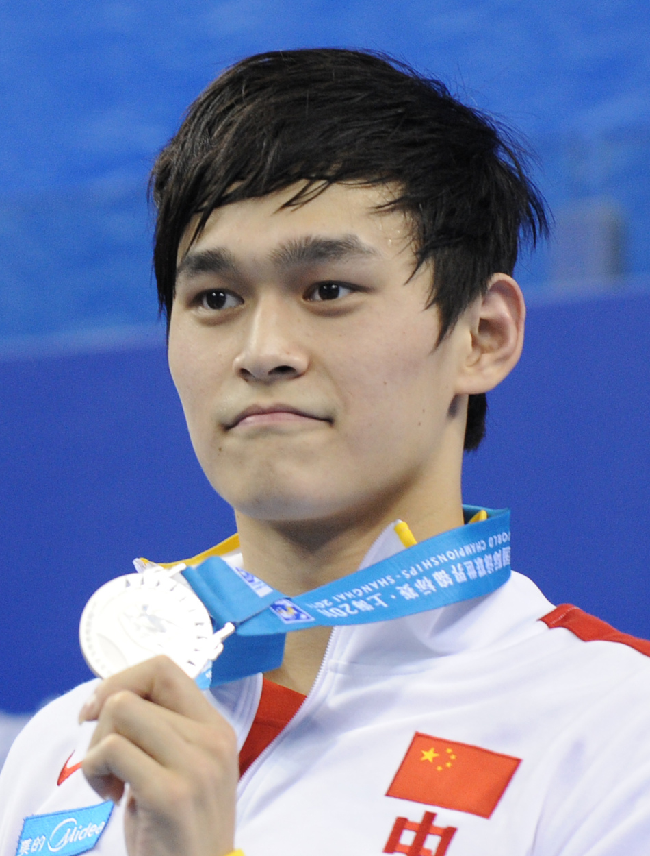
Sun Yang is a sportsman ________ is the first Chinese to win the Olympic gold medal in swimming.
who /that

Slide 9
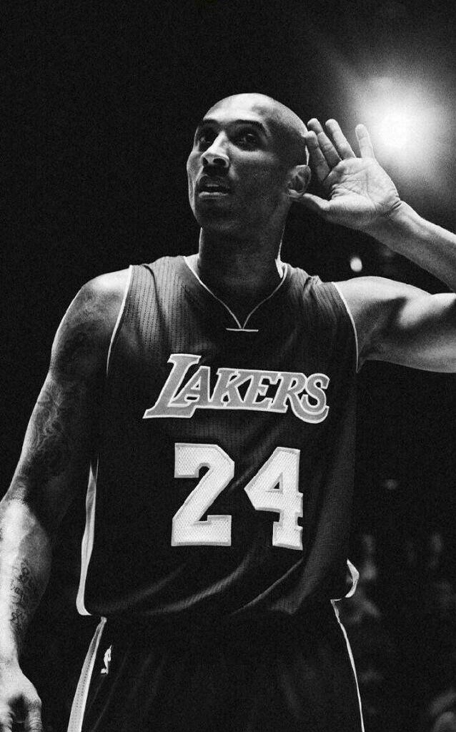
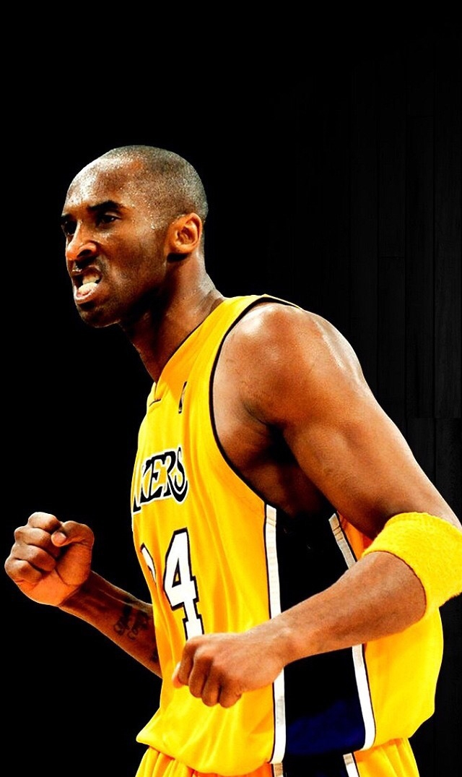
He is a very famous basketball player
＿＿＿＿
retired from NBA last year .
who/that

Slide 10
Peng Liyuan
Peng Liyuan is a graceful woman
＿＿＿＿＿＿＿＿＿ people call the first lady in China.
whom/who/that/--

Slide 11
Talking about past experiences
which /that
Robot is a machine _____________ can help people do many kinds of housework.

Slide 12
English is a language ____________ many people speak as their first ,second or foreign language.
which /that/--

Slide 13
whose
Huangshi is a beautiful city _______ people are kind and warm-hearted.
the people of the city

Slide 14
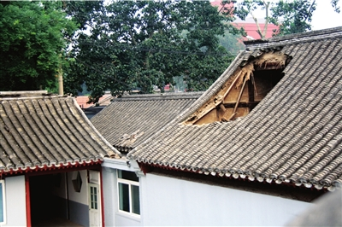
My grandfather lives in an old house
roof was broken last year.
whose

Slide 15
解题技巧
定语从句三步骤：
第一: 找到先行词
第二：分析先行词（指人/物）；
第三:确定合适的关系词
（做主语、宾语或表语）

Slide 16
Exercise 1
whose
1. I live next door to a couple（夫妻）______ children often make a lot of noise.
that/which
2. All my classmates enjoyed the cake _________ I made.
who/whom/that
3. The student ____________ the teacher praised (表扬) at the class meeting is our monitor(班长).
4. I know the boy ____________ you are looking for.
who/whom/that
whose
5. Anne was a Jewish girl best friend was her diary.

Slide 17
which/that
6. English is a language is spoken around the world.
7. They cycled along the Mekong River ________ begins Qinghai Province.
which/that
who/that
8. The number of people were killed or injured reached over 400,000.
who/whom/that
9. Nelson Mandela is a great black man _____________ people around the world think highly of.
10. I really like the story _________ my mother told.
that/which

Slide 18
Exercise 2
1. Robot is a machine who can help people do many kinds of housework.
which/that
2. The house which roof is red is mine.
whose
3. He is the man whom has much money.
who/that
4. I know the girl who hair is long and yellow.
whose
5.Football is a game whose is liked by most boys.
that/which

Slide 19
6. Yesterday I helped an old man whom lost his way.
who/that
7. The man whose you met last Sunday is my friend.
whom/that/who
8. Mr.Liu is the person whom talked with you on the bus.
who/that
9. He is just the boy which I want to see.
whom/that/who
10. The house which door has been destroyed is mine.
whose

Slide 20
Riddles to relax yourselves
1.What is the vegetable which/that can be made into French fries?
2.What is the dog which/that never bites?

Slide 21
Riddles to relax yourselves
3.What’s the animal which/that goes on four legs in the morning ,on two at noon ,and on three in the evening?

Slide 22
Guessing game
Describing and guessing
Describe one of your classmates and let
others guess who she/ he is.
Use sentences concerning the attributive
clause with who, whom, that.

Slide 23
Structures
Guessing game
He is a boy who/that …
She is a girl whose…
He is a boy who has the tallest legs in our class.
She is a girl whose hair is very long.
She is a girl who is good at math.
He is a boy who is always late for class.
......

Slide 24
Enjoy some proverbs (谚语）：
1. He who doesn't reach the Great Wall is not a true man.
2. He who laughs last laughs best.
3. God helps those who help themselves.
不到长城非好汉
笑到最后的人才是真正的赢家
天助者自助者

Slide 25
show time
Write a short passage about your friends! At least two attributive clauses should be included.
I have a friend whose name is Lily. She is a person who often helps others. Yesterday, I lost my wallet and I was very sad. But she gave me the money which her mother gave her right away.

Slide 26
Thank you!

